Slide 1

TOPIC- LibreOffice Calc
COURSE: CCC
CHAPTER: 03 (CALC)
NIELIT
Presentation By : Shruti Dubey

Slide 2
CALC Spreadsheet
Calc works with elements called spreadsheets. Spreadsheets consist of a number of individual sheets, each sheet containing cells arranged in rows and columns. A particular cell is identified by its row number and column letter.
A spreadsheet is a computer program that can capture, display and manipulate data arranged in rows and columns. Spreadsheets are one of the most popular tools available with personal computers. A spreadsheet is generally designed to hold numerical data and short text strings.

Slide 3
Syllabus
Elements of Spread Sheet, Creating of Spread Sheet, Concept of Cell Address [Row and Column] and selecting a Cell, Entering Data [text, number, date] in Cells, Page Setup, Printing of Sheet, Saving Spreadsheet, Opening and Closing, Manipulation of Cells & Sheet, Modifying / Editing Cell Content , Formatting Cell (Font, Alignment, Style ), Cut, Copy, Paste & Paste Special, Changing Cell Height and Width, Inserting and Deleting Rows, Column, AutoFill, Sorting & Filtering, Freezing panes, Formulas, Functions and Charts, Using Formulas for Numbers (Addition, Subtraction, Multiplication & Division), AutoSum, Functions (Sum, Count, MAX, MIN, AVERAGE), Sort, Filter, Advanced Filter, Database Functions ( DSUM, DMIN, DMAX, DCOUNT, DCOUNTA), What-if M Analysis, Pivot table Charts (Bar, Column, Pie, Line), Data Validation.

Slide 4
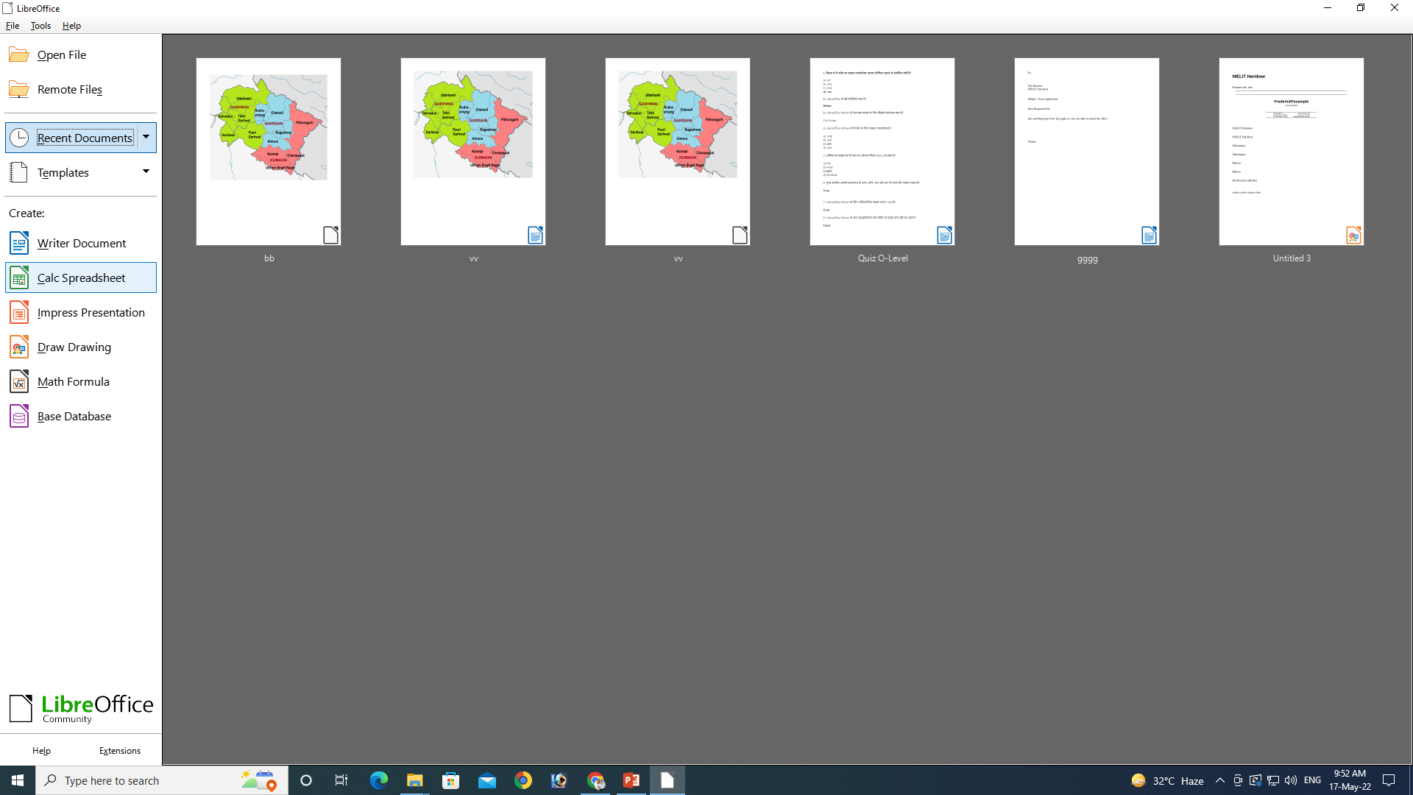
CALC Spreadsheet

Slide 5
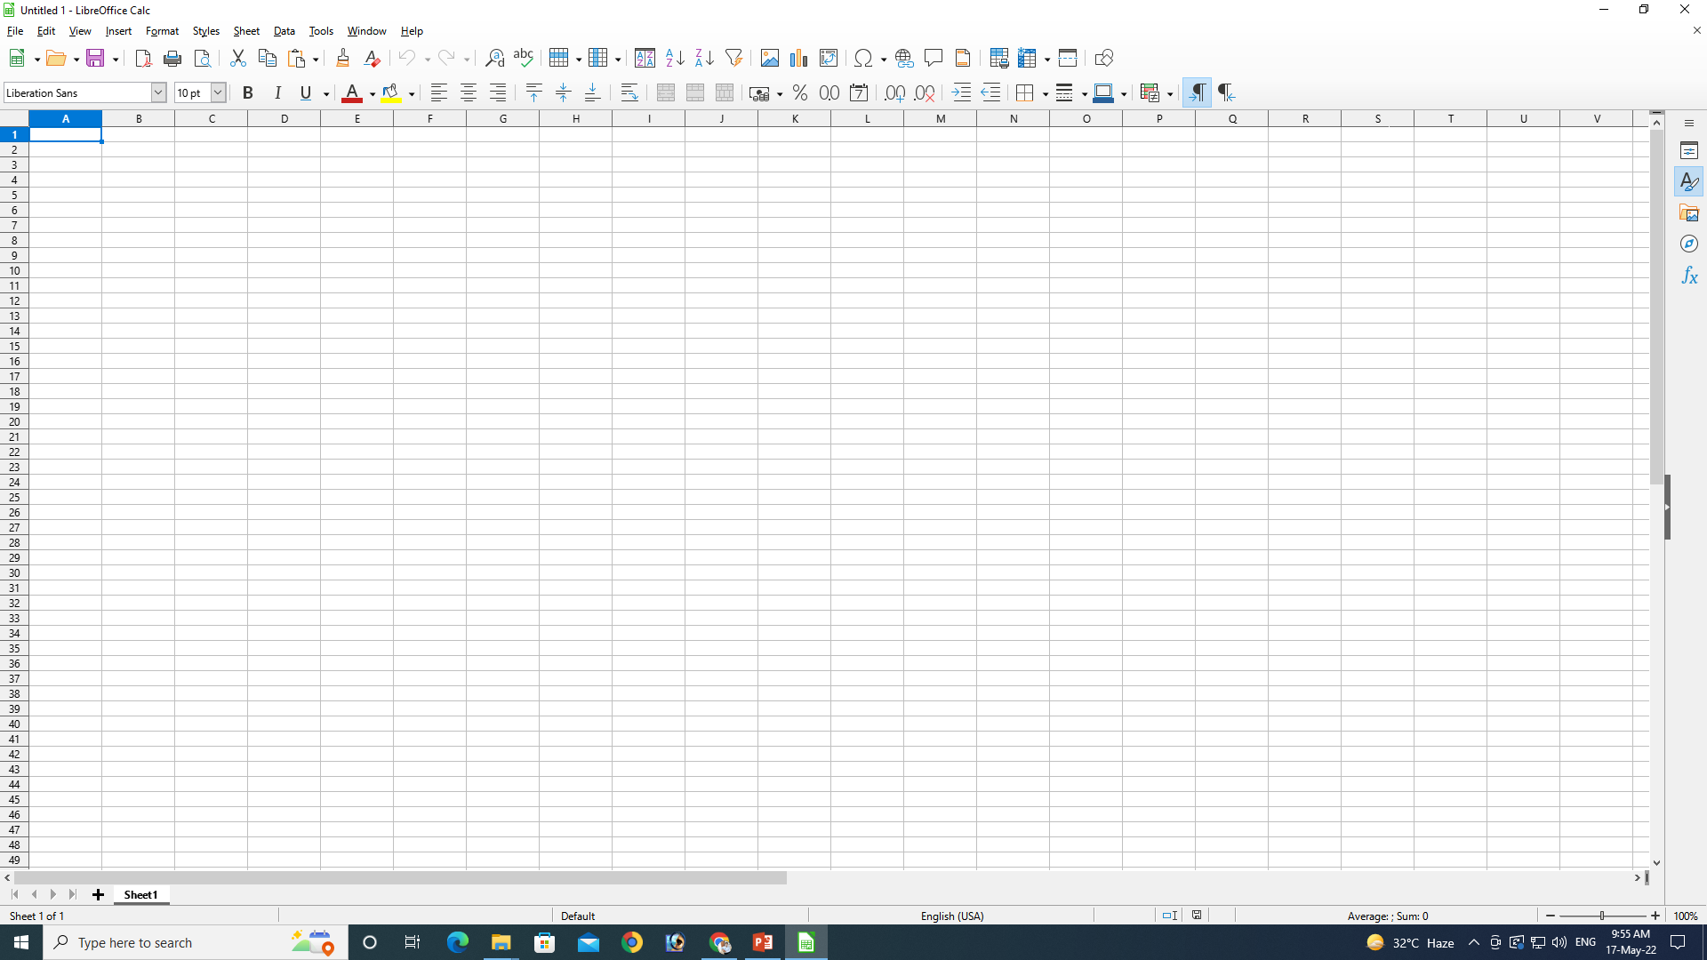
CALC Spreadsheet
Columns
Rows
Cell

Slide 6
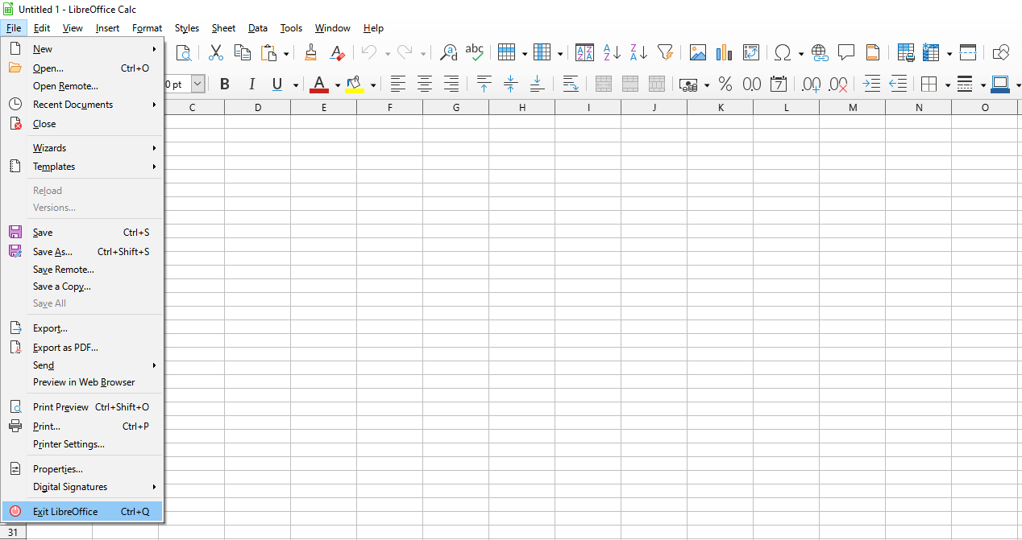
File Menu

Slide 7
File
These commands apply to the current document, open a new document, or close the application.
New
Creates a new Libre Office document.
Open
Opens a local or remote file, or imports one.
Recent Documents
Lists the most recently opened files. To open a file in the list, click its name.
Close
Closes the current document without exiting the program.
Wizards
Guides you through creating business and personal letters, faxes, agendas, presentations, and more.
Templates
Lets you organize and edit your templates, as well as save the current file as a template.
Reload
Replaces the current document with the last saved version.

Slide 8
Versions
Saves and organizes multiple versions of the current document in the same file. You can also open, delete and compare previous versions.
Save
Saves the current document.
Save As
Saves the current document in a different location, or with a different file name or file type.
Save All
Saves all modified Libre Office documents.
Export
Saves the current document with a different name and format to a location that you specify.
Export as PDF
Saves the current file to Portable Document Format (PDF) version 1.4. A PDF file can be
viewed and printed on any platform with the original formatting intact, provided that
supporting software is installed.

Slide 9
Send
Sends a copy of the current document to different applications.
Preview in Web Browser
Creates a temporary copy of the current document in HTML format, opens the system
default Web browser, and displays the HTML file in the Web browser.
Print Preview
Displays a preview of the printed page or closes the preview.
Print
Prints the current document, selection, or the pages that you specify. You can also set the print options for the current document. The printing options can vary according to the printer and the operating system that you use.
Printer Settings
Select the default printer for the current document.
Document Properties
Displays the properties for the current file, including statistics such as word count and the date the file was created.
Digital Signatures
Adds and removes digital signatures to and from your document. You can also use the dialog to view certificates.
Exit
Closes all Libre Office programs and prompts you to save your changes. This command does not exist on mac OS systems.

Slide 10
Thank You
NIELIT
Presentation By : Shruti Dubey

